Slide 1
Heart Disease Case Study
What features are most important in determining the likelihood of a heart attack?
Notes:
Patient enters ER complaining about typical heart attack symptoms: tightness or pain in the chest, neck, back, or arms, as well as fatigue, lightheadedness, abnormal heartbeat, and anxiety.
Um rush them to ER and treat as if having a heart attack!

Slide 2
How can a hospital staff member quickly identify a patient’s risk of heart attack?
301 Patients
Half had heart attacks
Various features show patient risk
Notes:
But what if a patient isn’t complaining about any symptoms.
Can we use routine questions and simple testing to assess a patient’s risk?

Slide 3
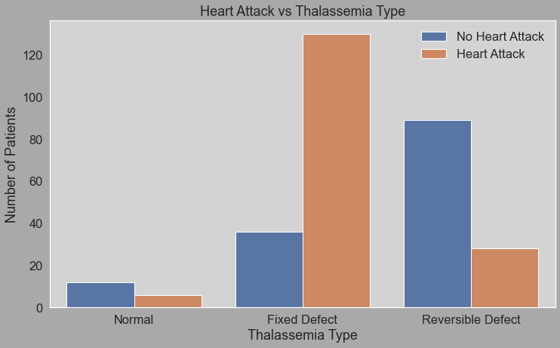

Fixed Type Thalassemia
=
Higher risk of heart attack
Notes:
Lets first ask
Do you have Thalassemia?
If no, risk diminishes
If yes,
Do you know if it’s fixed or reversible?
If fixed approximately three times as likely to have a heart attack

Slide 4
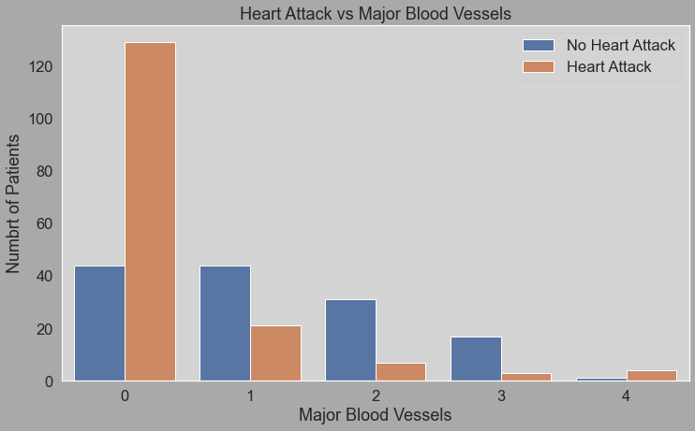
More blood vessels blocked
=
Higher risk of heart attack
Notes:
Next,
How many of your major blood vessels are blocked? Kidding.
We can ask questions to assess the likelihood clots are present.
Do you have a history of blood clots?
Do you have any of the following symptoms?
Swelling
Change in color
Pain
Trouble breathing
Pain in chest
Feel dizzy
Unusual sweating
Leg cramps
Problem with vision
Nausea or vomiting
Severe pain in your belly, which may be worse after you eat
Diarrhea
Bloody stools
A sensation that feels like you're bloated
Pain in the side of your belly, legs, or thighs
Blood in your urine
Fever

Slide 5
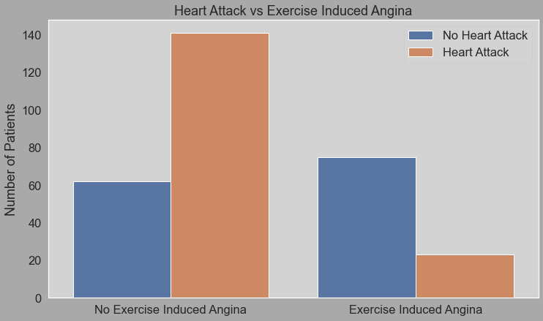
No exercise induced angina
=
Higher risk of heart attack
???
Notes:
Do you have exercise induced angina?
Angina is a symptom of coronary artery disease and is a type of chest pain caused by reduced blood flow to the heart.
Feels like squeezing, pressure, heaviness, tightness or pain in the chest. Can be sudden or recur over time.
So NOT having exercise induced angina means your twice as likely to have a heart attack? Why?

Slide 6
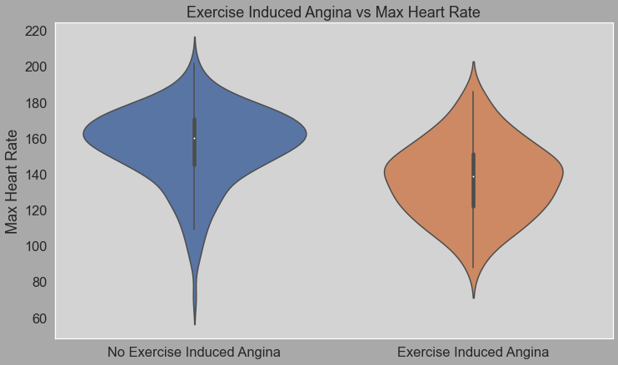
Exercise induced angina
=
Lower maximum heart rate
Notes:
Patients who suffer from exercise induced angina tend to have lower maximum heart rates

Slide 7
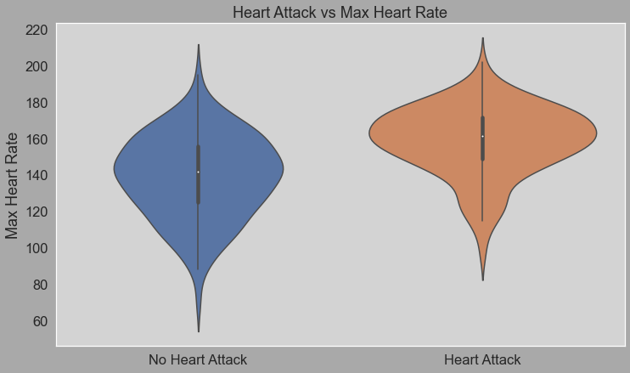
Higher maximum heart rate
=
Higher risk of heart attack
Notes:
And higher maximum heart rates are associated with heart attacks.

Slide 8
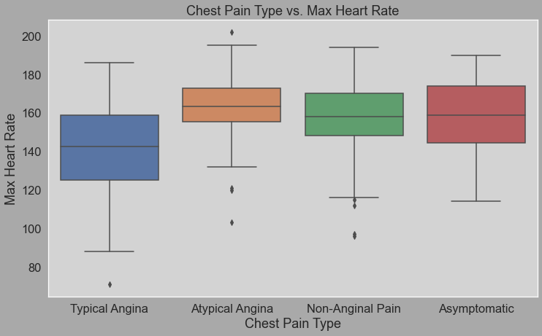
Typical Angina
=
Lower maximum heart rate
Notes:
Patients with typical angina tend to tend to have slightly lower maximum heart rates

Slide 9
High maximum
heart rate
Treat patient for heart attack
Notes:
So how can we use this information?
The moral of the story.
If a patient has a high maximum heart rate treat them for a heart attack.

Slide 10
Routine questions can help distinguish heart attack risk
Fixed Type Thalassemia
Blocked major blood vessels
High maximum heart rate
Notes:
Patients with fixed type thalassemia, blocked major blood vessels, or high maximum heart rates are at increased risk for heart attacks.
By asking questions and using simple testing procedures (if needed) we can increase our ability to assess patient heart attack risk.

